Slide 1
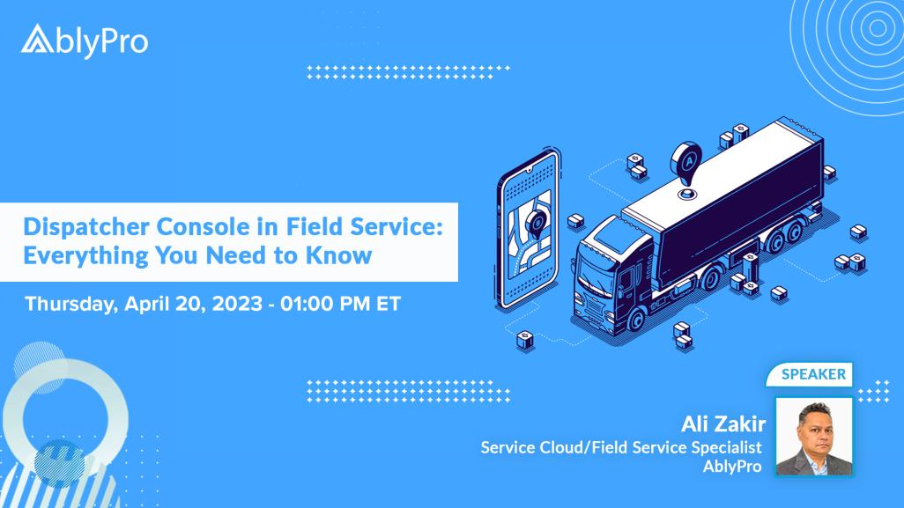

Slide 2




DISPATCHER CONSOLE IN FIELD SERVICE
Everything You Need to Know
Deep dive into Dispatcher Console
View all territories and technicians with Gantt View
How to eliminate geographical location challenges with Territories
Importance of Filters
Understanding Map View
Scheduling Optimizer
Agenda

Slide 3

Real-Time >>

Slide 4


Slide 5



Contact Us
Salesforce Service Cloud & Field Service Success Consultant
Address
AblyPro
12410 Milestone Center Drive
Suite 600
Germantown, MD 20876
Phone & Email
240-259-3076
wecare@ablypro.com
Social Media
Facebook.com/ablypro
Twitter.com/ablypro
Linkedin.com/company/ablypro

