Slide 1
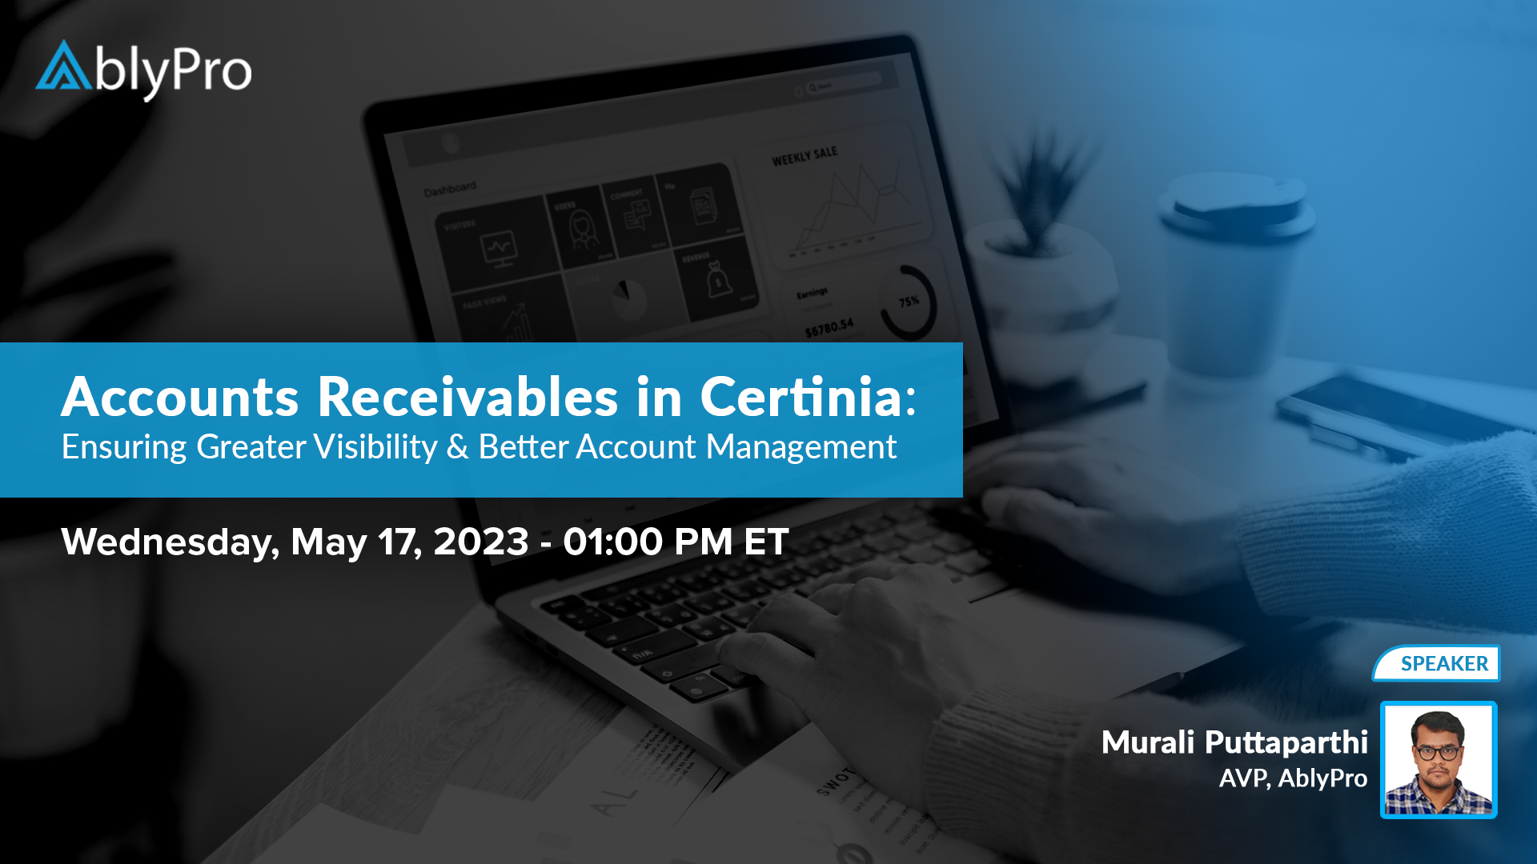

Slide 2
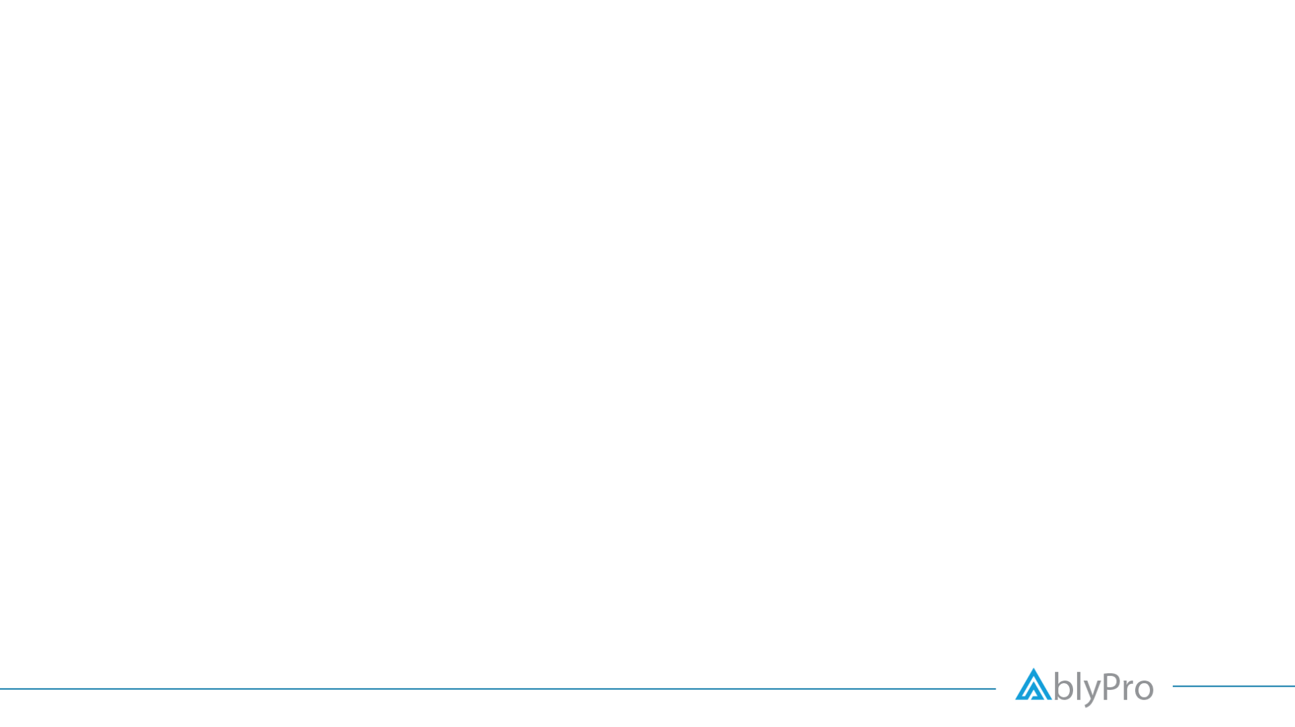



ACCOUNTS RECEIVABLES IN FINANCIALFORCE
Ensuring Greater Visibility & Better Account Management
The Need for an Accounts Receivable Software
Accounts Receivable - An Overview of the Process
How to Create and Amend Invoices
Recurring Invoices
Background Posting Scheduler
Edit and Issue Sales Credit Note Transmit and Monitor Invoices
As of Aging
Collection Plus
Agenda

Slide 3

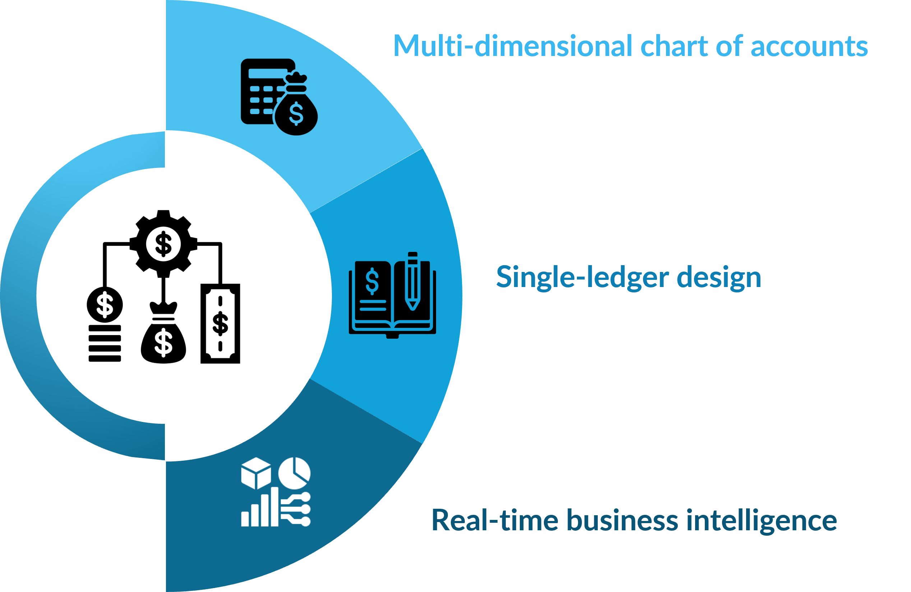
Why the Need for
Accounts Receivable Software

Slide 4
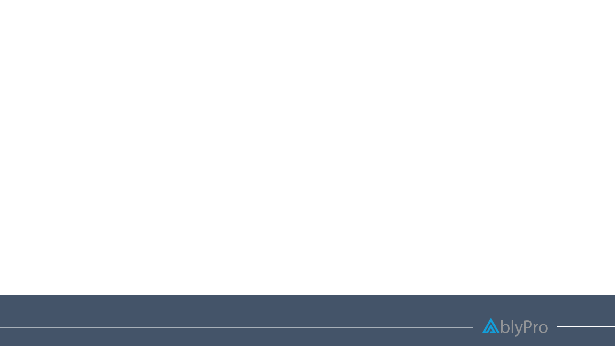
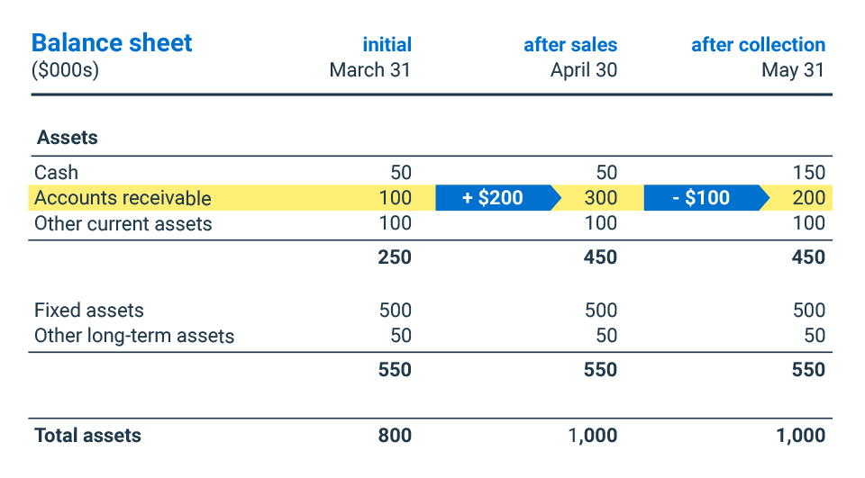
Overview: Accounts Receivables
Accounts Receivable (AR) are the balance of money due to a firm for goods or services delivered or used but not yet paid for by customers. Accounts receivable are listed on the balance sheet as a current asset. Any amount of money owed by customers for purchases made on credit is AR.
This module is mainly tailored towards your customer’s life cycle.
Sending invoices, issuing credit notes, receiving cash against invoices, cash matching, customer statements – all fall under AR.
Source: BDC.ca
Notes:
Salesforce Platform report audience : Accountant and System Admin.
Ideal for generating quick ad reports
Data list / data loader source
Dashboards.

Slide 5
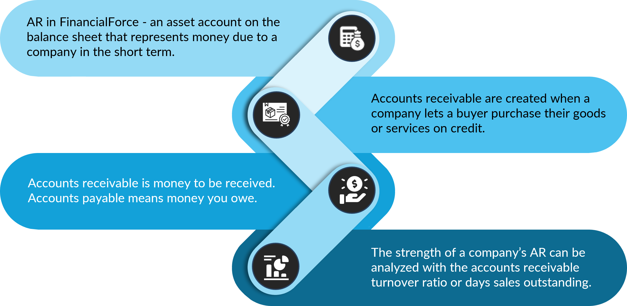
Overview: Accounts Receivables
Notes:
Salesforce Platform report audience : Accountant and System Admin.
Ideal for generating quick ad reports
Data list / data loader source
Dashboards.

Slide 6
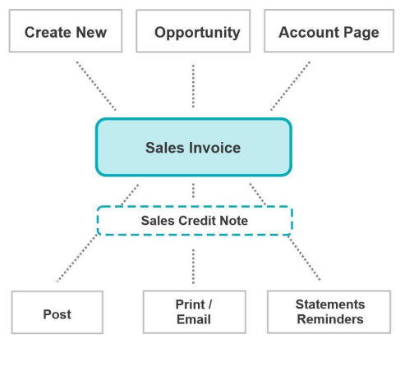
Accounts Receivables
The Process
Once you create an invoice, and post it, you can process it several ways - print, email, and send statement reminders.
There are some additional buttons on the list view that allow you to post.
To start the billing process, we use Sales Invoices to list out the charges for each product or services customers have ordered.
A sales invoice can be created in 3 ways:
  From scratch and connect it to an existing Opportunity or leave the Opportunity field blank if one is not needed.
  From the Opportunity which will carry the relevant information directly to a new Sales Invoice.
  From the Account’s page related list.
Notes:
Salesforce Platform report audience : Accountant and System Admin.
Ideal for generating quick ad reports
Data list / data loader source
Dashboards.

Slide 7
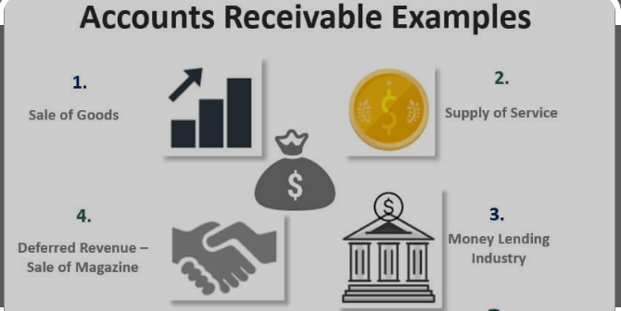
Accounts Receivables
Example
An example of accounts receivable includes an electric company that bills its clients after the clients received the electricity. The electric company records an account receivable for unpaid invoices as it waits for its customers to pay their bills.
Most companies operate by allowing a portion of their sales to be on credit. Sometimes, businesses offer this credit to frequent or special customers that receive periodic invoices. The practice allows customers to avoid the hassle of physically making payments as each transaction occurs. In other cases, businesses routinely offer all their clients the ability to pay after receiving the service.
Notes:
Salesforce Platform report audience : Accountant and System Admin.
Ideal for generating quick ad reports
Data list / data loader source
Dashboards.

Slide 8
How to Create & Amend Invoices in FinancialForce
A sales invoice is an accounting document sent by a provider of goods/services to a purchaser. It records services rendered, items provided, the amount owed by the customer, and how they can make payment. Invoices create legally binding agreements between companies and buyers, especially for larger purchases.
3 ways to creating Sales Invoices in FinancialForce:
Sales Invoice
Create New (from App Launcher)
Opportunity
Account page
Notes:
Salesforce Platform report audience : Accountant and System Admin.
Ideal for generating quick ad reports
Data list / data loader source
Dashboards.

Slide 9
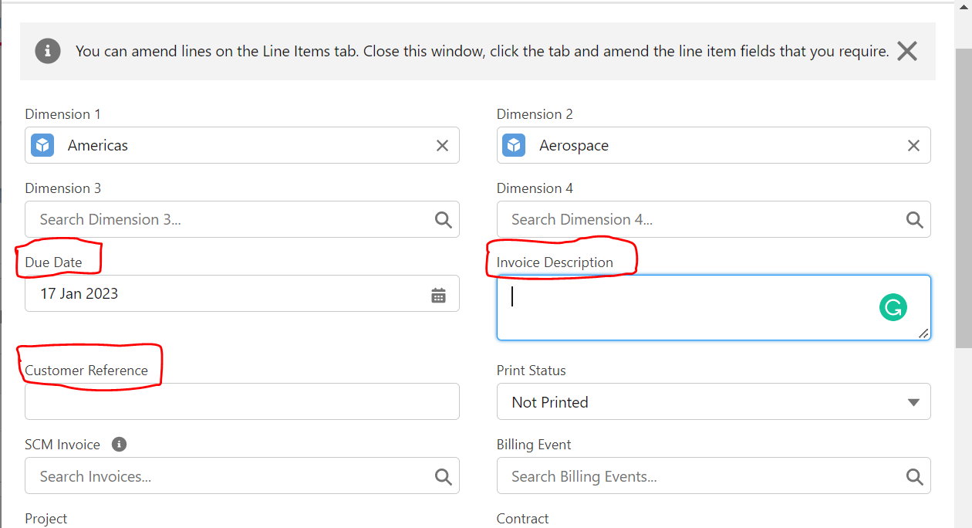
How to Create & Amend Invoices in FinancialForce
On posted invoices, only specific fields can be amended.
  Due Date
  Invoice Description
  Customer reference
  Line Descriptions
Optionally, you can have Dimensions amended if the custom setting is turned on.
Notes:
Salesforce Platform report audience : Accountant and System Admin.
Ideal for generating quick ad reports
Data list / data loader source
Dashboards.

Slide 10
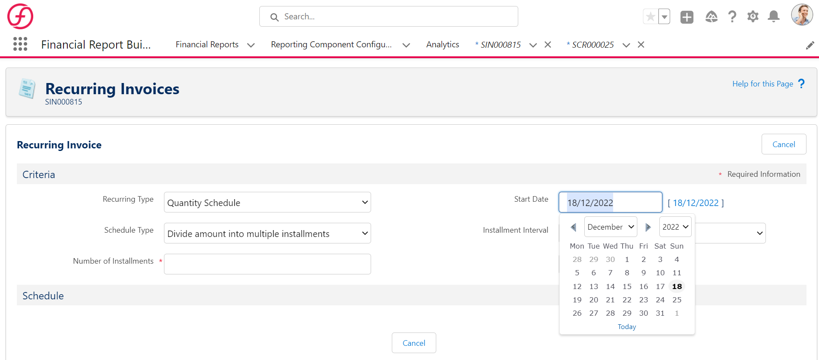
Recurring Invoices
Recurring Invoice functionality enables you to create similar Sales Invoices multiple times for the same account with different invoice and due dates.
How it Works?
You can select any “In Progress” invoice and have FFA create recurring invoices for you. The new invoices can be set up to divide the total amount of the original invoice into multiple invoices or it can create new invoices using the exact amount used on the original invoice.
Notes:
Salesforce Platform report audience : Accountant and System Admin.
Ideal for generating quick ad reports
Data list / data loader source
Dashboards.

Slide 11

Background Posting Scheduler
Background Posting Scheduler exists to handle larger volume requirements. It will run invoices that have the “Ready to Post” status. Any invoices posted from the list view will use the BPS, invoices with a high number of lines or invoices with income schedules.
Documents can be posted by clicking the Run Now button on the BPS tab or by clicking the Background Posting button found on documents list view.
You can monitor the process by going to Setup > Apex Jobs.
If an Invoice using BPS cannot post for any reason, it will be reflected in the Worker Log.
An email notifies whether the process was successful or not. If the process fails to post the document, its status is set back to In Progress.

Slide 12

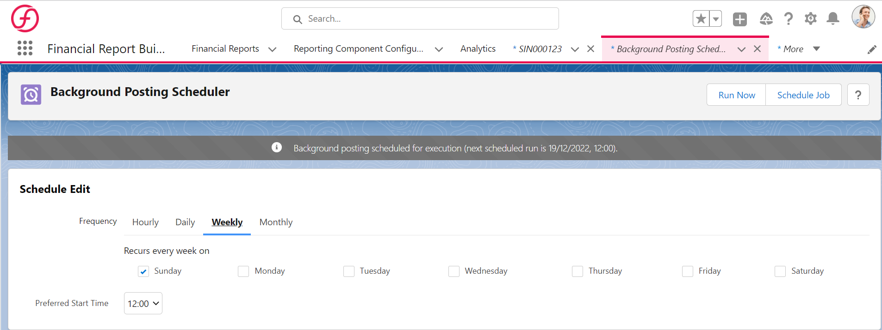
Background Posting Scheduler

Slide 13

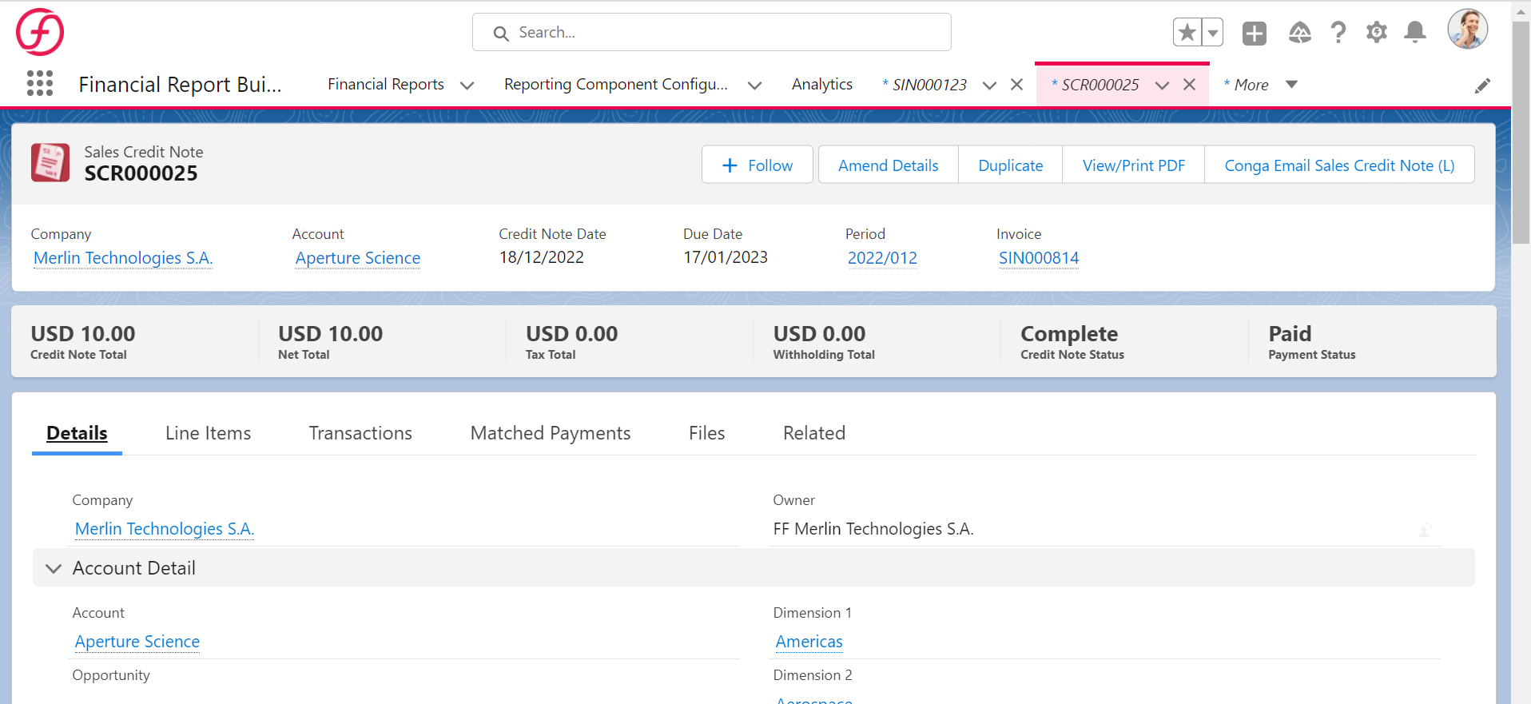

Edit & Issue Sales Credit Notes
Sales Credit Notes are documents used to rectify errors or issue refunds (ex: damaged, returned goods) against a Sales Invoice that has already been sent to a customer. Sales Credit Notes create a reversing entry against the original Transaction.
Example
To keep good relations with the company after billing for the wrong amount, management has decided to credit them with one month of the consulting fee.
The most efficient way to generate a sales credit note is to generate it from the invoice that was done incorrectly. That’s why you see it shown after the Sales Invoice.

Slide 14

Transmit & Monitor
Invoices
Why The Need?
As a part of the weekly AR responsibilities, it is crucial to assess the state of company’s receivables from past billing.
Example
We are asked by our supervisor to implement a process of sending payment reminders prior to the actual invoice due date, to see if that improves payment compliance.
They decide to use 15 days prior to the due date, and we sets up the reminder rule.
Notes:
Salesforce Platform report audience : Accountant and System Admin.
Ideal for generating quick ad reports
Data list / data loader source
Dashboards.

Slide 15
As of Aging
Considerations
As of Aging must be run for each individual company that is set up in the FinancialForce Accounting environment.
Why Do You Need It?
As of Aging process allows for the generation of a detailed report that shows customer or vendor position at a historical point in time. Without this tool, it is only possible to run a report for the date it is run.
Run an As of Aging process to see how many outstanding invoices there are.
Additionally, copy the report and modify it, so it only shows transactions for Accounts Receivable.
Once the data is gathered for the aging, view the details in a report.
How It Works?
An As of Aging Report will show how much each Customer or Vendor owes. (This looks at the aging of debt.)
Notes:
Salesforce Platform report audience : Accountant and System Admin.
Ideal for generating quick ad reports
Data list / data loader source
Dashboards.

Slide 16
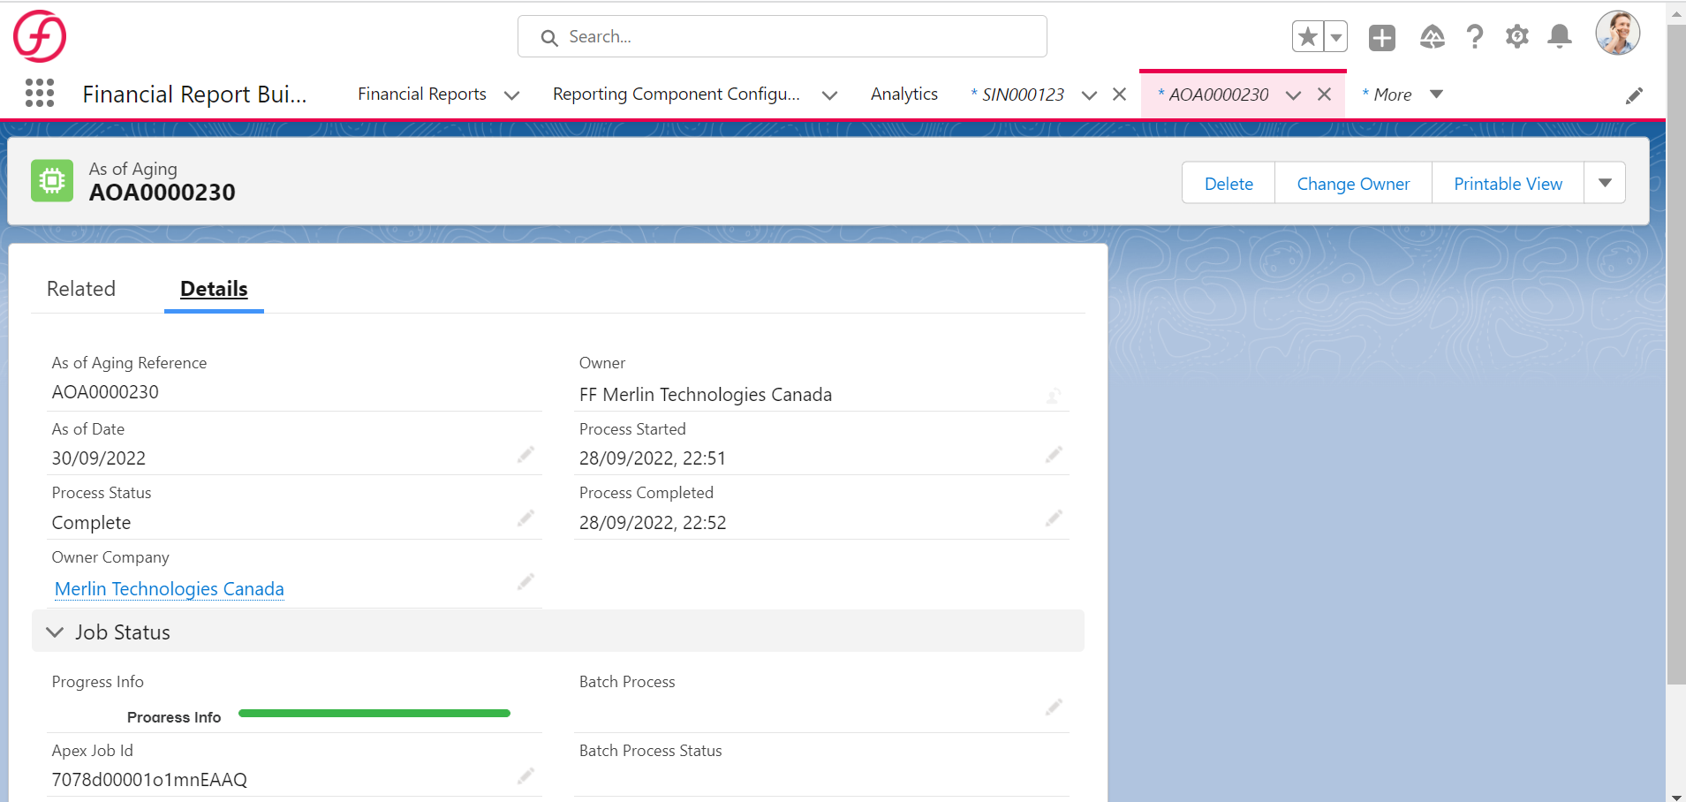
As of Aging
Notes:
Salesforce Platform report audience : Accountant and System Admin.
Ideal for generating quick ad reports
Data list / data loader source
Dashboards.

Slide 17
Collection Plus
The Statements section shows the statement rule for the selected company and the number of statements that are due to be sent. You can click on the number of statements to be sent to view details of the accounts that have statements to send.
You can use the Customer Statements section on the Collections pages to send statements to your customers.
Considerations
If you have multiple companies in your org, you can send statements from each of those companies. On the Collections home page, your current company is selected by default. You can select another company to view the customer statements to be sent for that company.
If you exclude accounts from the customer statements process, those accounts are still available to have statements sent. The to Send column includes the number of accounts that were excluded.

Slide 18

Collection Plus
Statement Rules
You can configure customer statement rules to automatically select accounts that contain unpaid and part-paid invoices for the previous month. You can then use Collections Plus to view the statements that are due to be sent, generate statements for those accounts, and email them to your customers. Customer statements are only sent to the Finance Contact on the Account record.
With FinancialForce Accelerate, the Collections Plus configuration delivers several standard reminder rules, email templates, and customer statement templates.
Collections Plus is a tool created to streamline the reminders and collections processing.
Reminder rules can be created to specify frequency at which payment reminders are sent to customers based on specific criteria (i.e. 5 days before due date, 7 days after due date, etc.)
Customer contacts for reminders/collections/statement notifications are defined on the associated account record in the Finance Contact fields.
Customer statements can also be generated and sent via Collections Plus.
Standard templates for reminder notifications and statements are provided via the Conga integration.

Slide 19


Contact Us
Certinia and Salesforce Success Consultant
Address
AblyPro
12410 Milestone Center Drive
Suite 600
Germantown, MD 20876
Phone & Email
240-259-3076
wecare@ablypro.com
Social Media
Facebook.com/ablypro
Twitter.com/ablypro
LinkedIn.com/company/ablypro

